Slide 1


What is cloud computing

Slide 2

What is cloud computing…?
Think of it as renting what you need instead of owning it.
Example: Instead of buying your own storage device, you use services like Google Drive or Dropbox to store your files online and access them from anywhere.
Cloud computing works similarly but with computers, storage, and software. Instead of owning physical hardware and managing everything yourself, you rent computing power, storage, and services from companies like Amazon Web Services (AWS), Microsoft Azure, or Google Cloud.

Slide 3
Comparing traditional IT to Cloud computing
Aspect | Traditional IT 🖥️ | Cloud Computing ☁️
Infrastructure | Own servers 🏢 | Shared resources 🌎
Setup Time | Long ⏳ | Quick ⚡
Cost | High upfront 💸 | Pay-as-you-go 💳
Scalability | Limited 📏 | Flexible 📈
Maintenance | Manual 🔧 | Handled by provider 🤝
Access | On-premise 🏠 | Anywhere with internet 🌐
Disaster Recovery | Risk of data loss ⚠️ | Built-in backup 🛠️
Software Updates | Manual installation 🛠️ | Automatic updates 🔄
Energy Use | High power consumption 🔋 | Optimized by provider 🔌

Slide 4
Aspect | Traditional IT | Cloud Computing
Infrastructure | Requires physical servers, data centers, and hardware. | Uses virtual servers and shared resources over the internet.
Upfront Cost | High upfront investment for hardware, software, and setup. | Pay-as-you-go pricing with little to no upfront cost.
Scalability | Scaling requires buying and installing new hardware. | Instantly scalable up or down as needed.
Maintenance | Businesses handle hardware updates, repairs, and software. | Maintenance is handled by the cloud provider.
Accessibility | Limited to on-site access or complex VPN setups. | Accessible anywhere with an internet connection.
Deployment Time | Can take weeks or months to deploy new systems. | Services can be deployed in minutes.
Flexibility | Less flexible, tied to purchased hardware and software. | Highly flexible with a variety of services and configurations.
Disaster Recovery | Requires dedicated resources for backups and recovery plans. | Built-in disaster recovery options are often available.
Energy Efficiency | Requires energy to run and cool physical servers. | Providers optimize energy usage across shared infrastructure.
Skill Requirements | Needs in-house IT staff for maintenance and troubleshooting. | Limited in-house IT skills needed; provider manages most tasks.

Slide 5
Benefits of using cloud computing
1. Cost Savings 💰
No need for expensive hardware, physical infrastructure, or maintenance.
Pay-as-you-go model ensures you only pay for what you use.
2. Scalability 📈
Easily scale resources up or down based on demand.
Perfect for businesses with fluctuating workloads.
3. Accessibility 🌐
Access your data and applications from anywhere with an internet connection.
Encourages remote work and collaboration.
4. Performance ⚡
Cloud providers offer high-speed networks and efficient data centers.
Ensures minimal latency and maximum uptime.
5. Reliability 🤝
Built-in disaster recovery and backup solutions reduce the risk of data loss.
High availability and redundancy across servers.

Slide 6
Benefits of using cloud computing continue
6. Security 🔒
Advanced security features such as encryption, firewalls, and access controls.
Continuous monitoring to detect and prevent cyber threats.
7. Automatic Updates 🔄
Providers handle software and hardware updates, ensuring you’re always using the latest technology.
8. Environmental Benefits 🌱
Optimized resource sharing reduces energy consumption and carbon footprint.
9. Innovation 🚀
Access to advanced technologies like AI, machine learning, and big data analytics without heavy investments.
10. Flexibility 🛠️
Variety of services (e.g., storage, computing power, databases) tailored to different needs.
Multi-cloud and hybrid solutions offer more customization.

Slide 7
Types of Cloud Computing
1. Deployment Models: cloud deployment model identifies the specific type of cloud environment based on ownership, scale, and access, as well as the cloud's nature and purpose . The location of the servers you're using and who controls them are defined by a cloud deployment model.
Public Cloud
Private Cloud
Hybrid Cloud
Community Cloud
2. Service Models: cloud service models allow users or organizations to build custom software applications by providing the right ecosystem .
Infrastructure as a Service (IaaS)
Platform as a Service (PaaS)
Software as a Service (SaaS)

Slide 8
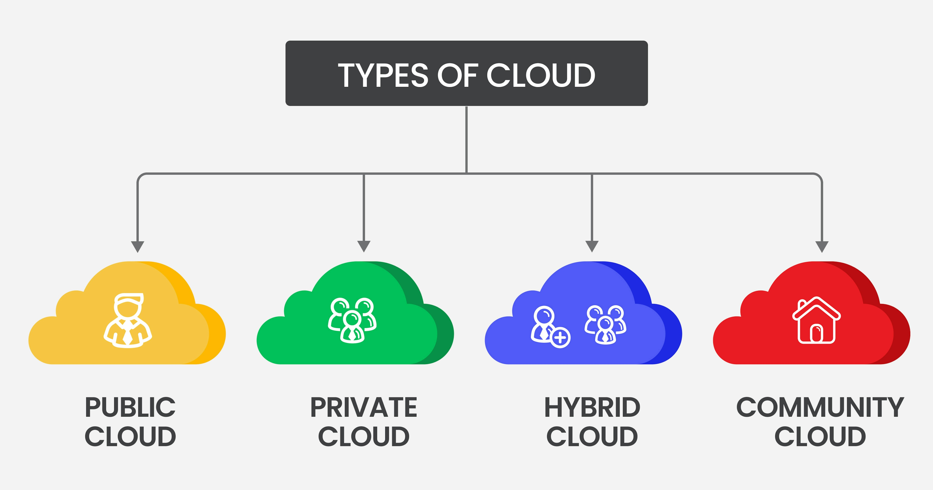
Deployment model

Slide 9
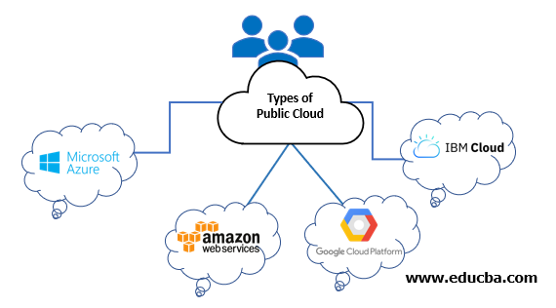
Public Cloud: Services are provided over the internet by a third-party cloud provider, and resources are shared among multiple customers.
Key Features:
Accessibility: Accessible from any internet-connected device 🌐.
Scalability: High scalability; resources can be quickly scaled up or down as needed 🔄.
Cost-Effective: Pay-as-you-go pricing model; users pay only for the resources they consume 💸.
Examples: AWS, Microsoft Azure, Google Cloud Platform.

Slide 10
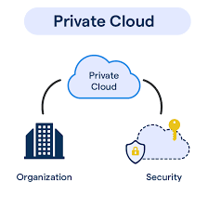
Private Cloud: A private cloud is dedicated to a single organization. It can be hosted on-premises or by a third-party provider.
Key Features:
Security: More secure as resources are dedicated solely to one organization 🔐.
Control: Greater control over the cloud environment, including security and compliance ⚙️.
Flexibility: Can be customized according to specific business needs 📊.
Examples: VMware vSphere, OpenStack.

Slide 11
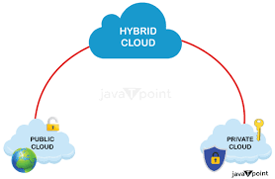
Hybrid Cloud: A combination of public and private clouds, allowing data and applications to be shared between them.
Key Features:
Flexibility: Balances scalability and control; workloads can be moved between public and private clouds based on demand 📈.
Integration: Allows existing on-premises IT resources to integrate with public cloud resources 🔗.
Data Management: Useful for companies with specific data residency requirements 📍.
Examples: Combining AWS with on-premises IT infrastructure.

Slide 12
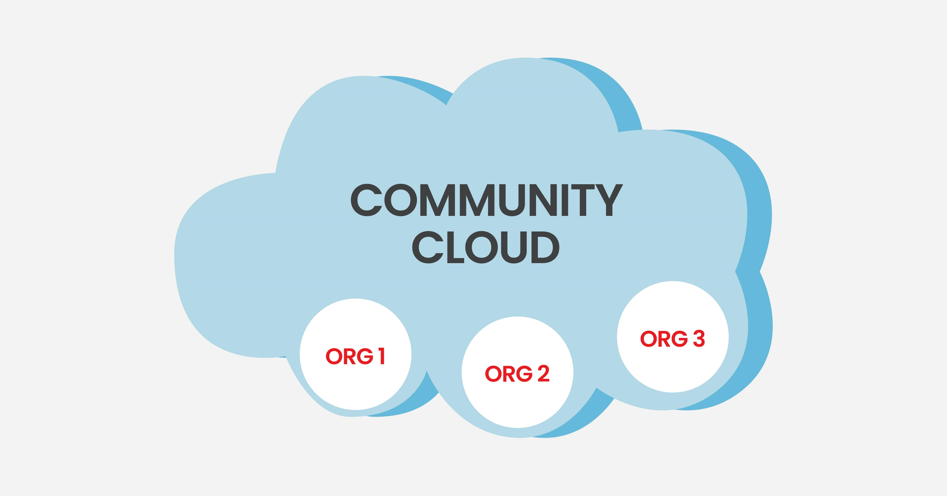
Community Cloud: Shared by several organizations with similar requirements (e.g., same industry standards).
Key Features:
Shared Goals: Cost-effective shared infrastructure for specific community use 🌐.
Security: Similar to private cloud in terms of security but shared among a group 🔒.
Compliance: Meets specific regulatory requirements for the community 📜.
Examples: A community cloud for government agencies or non-profits.

Slide 13
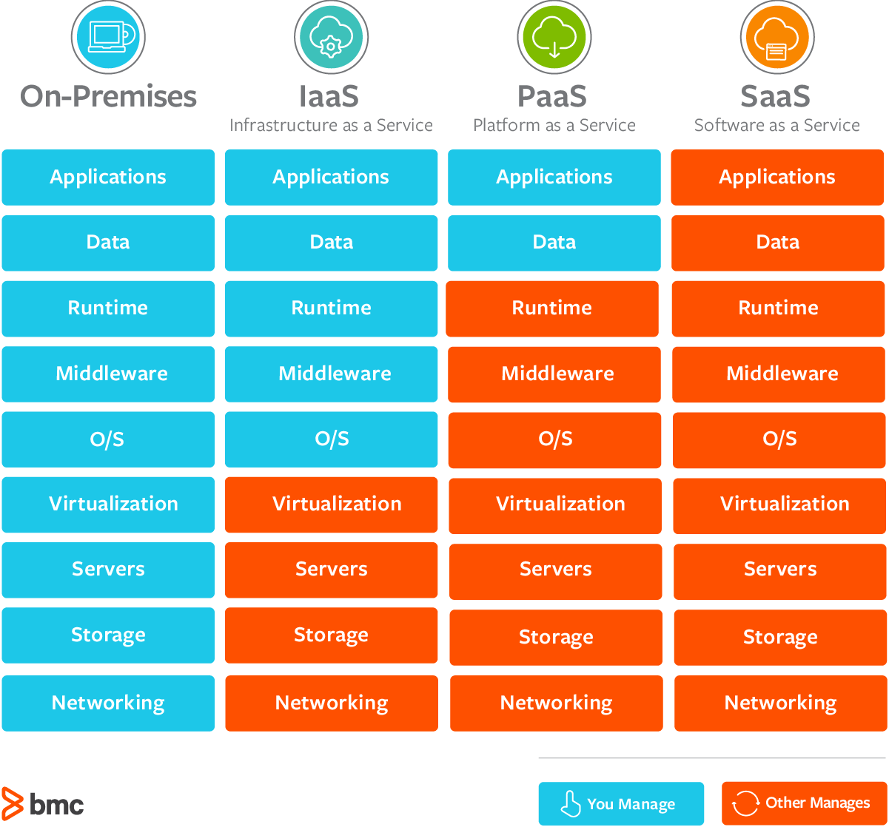
Service Models
IAAS
PAAS
SAAS

Slide 14
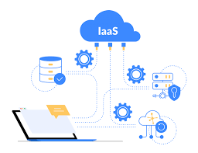
Infrastructure as a Service (IaaS): Provides virtualized computing resources over the internet. Users can rent virtual machines (VMs), storage, and networking infrastructure on an as-needed basis.
Customization: Users have control over the operating system, network configuration, and storage 🛠️.
Cost Efficiency: Pay only for the resources used 💸.
Scalability: Easily scale computing power up or down 📈.
Examples: AWS EC2, Microsoft Azure Virtual Machines, Google Compute Engine.
Imagine you want to build a new website. Instead of buying physical servers, installing operating systems, and configuring network infrastructure, you can rent these resources from a cloud provider.

Slide 15
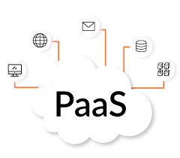
Platform as a Service (PaaS): Provides a computing platform and solution stack as a service. Users can build, run, and manage applications without dealing with the underlying infrastructure.
Development Tools: Includes development, database, and business analytics tools 🛠️.
Simplified Management: Managed environments for building applications 💼.
Scalability: Automatically scales applications 📈.
Examples: AWS Elastic Beanstalk, Microsoft Azure App Service, Google App Engine.
Imagine you're a developer wanting to build a web application. Instead of setting up servers, databases, and other infrastructure, you can use a PaaS platform to focus solely on coding your application.

Slide 16
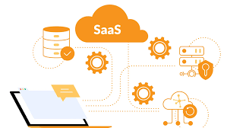
Software as a Service (SaaS): Provides software applications over the internet. The provider manages everything from infrastructure to application maintenance.
Accessibility: Accessible from any device with a web browser 🌐.
Cost-Effective: No upfront costs for software installation; subscription-based pricing 💸.
Automatic Updates: The provider handles software updates and maintenance 🔄.
Examples: Google Workspace, Microsoft 365, Salesforce.
Imagine you're a small business owner and you need a tool to manage your customer relationships, track sales, and automate marketing tasks. Instead of buying and installing software on your own computers, you can use a SaaS solution.

Slide 17
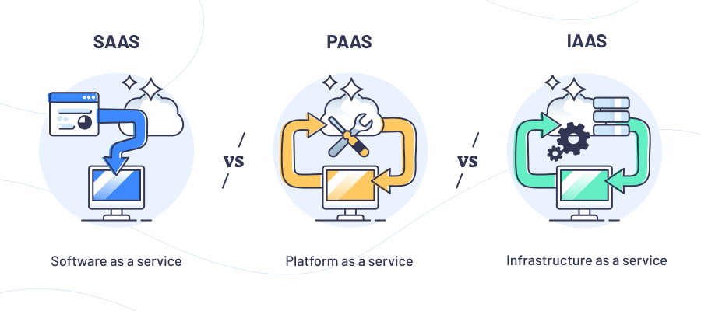
Difference between IAAS PASS SAAS

Slide 18
Feature | IaaS 🛠️ | PaaS 🚀 | SaaS 🌐
Description | Infrastructure as a Service: Rent virtualized resources like servers, storage, and networks. | Platform as a Service: Use tools to build, test, and deploy apps without managing infrastructure. | Software as a Service: Access ready-to-use applications over the internet.
Control Level | High: Full control over servers, OS, and storage. | Medium: Focus on application development, not infrastructure. | Low: Just use the application; everything else is managed.
Management | User manages OS, middleware, and runtime. | Provider manages infrastructure; user manages apps. | Provider manages everything, including maintenance and updates.
Target Users | IT administrators, developers needing flexibility. | Developers focusing on app building and testing. | End-users needing easy-to-use apps.
Examples | AWS EC2, Microsoft Azure VMs, Google Compute Engine. | AWS Elastic Beanstalk, Microsoft Azure App Service, Google App Engine. | Google Workspace, Microsoft 365, Salesforce.
Use Case | Hosting websites, data storage, disaster recovery. | Building and deploying custom apps. | Email, CRM, collaborative tools.
Setup Complexity | High 🛠️ | Medium ⚙️ | Low ✅

Slide 19
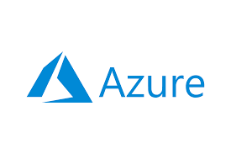

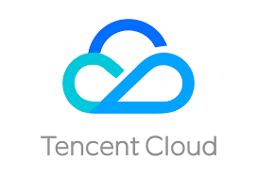

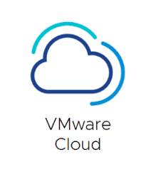
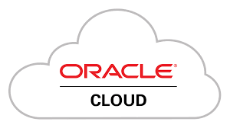


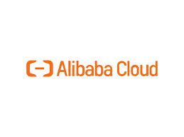
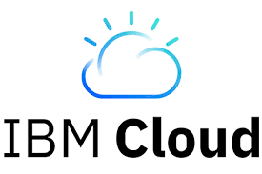
Popular cloud service providers globally

Slide 20
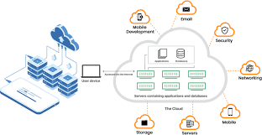
How Cloud Computing Works…?
Front End: Users interact with the cloud using web browsers, mobile apps, or other interfaces.
Back End: Data and applications are stored and processed on powerful servers located in data centers around the world.
Internet: Acts as the bridge that connects the front end to the back end.

Slide 21
Let’s see few AWS Services ….

Slide 22
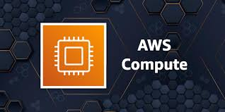
Let’s see few AWS Services ….
1. Compute Services:
AWS provides scalable and flexible compute power.
Amazon EC2: Virtual servers in the cloud for running applications.
AWS Lambda: Serverless computing to run code in response to events.
Amazon Elastic Beanstalk: Simplified application deployment and management.
Amazon ECS/EKS: Managed container services for running Docker and Kubernetes workloads.
AWS Batch: Batch processing of large-scale jobs.

Slide 23
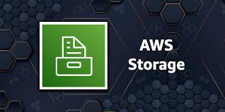
2. Storage Services
AWS offers a variety of storage solutions for different use cases.
Amazon S3: Scalable object storage for data backup and archival.
Amazon EBS: Block storage volumes for EC2 instances.
Amazon FSx: Managed file storage for Windows and Lustre.
Amazon Glacier: Low-cost storage for long-term archiving.
AWS Storage Gateway: Hybrid storage integration between on-premises and cloud.

Slide 24
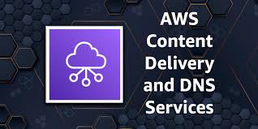
3. Networking and Content Delivery
Networking tools enable secure and fast data transfer.
Amazon VPC: Virtual Private Cloud for isolated networking.
AWS Direct Connect: Dedicated network connection to AWS.
Amazon CloudFront: Content Delivery Network (CDN) for faster content delivery.
Elastic Load Balancing: Distributes traffic across multiple instances.
AWS Route 53: Scalable Domain Name System (DNS).

Slide 25
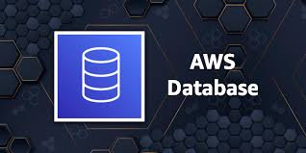
4. Database Services
AWS provides managed databases for relational, non-relational, and analytics workloads.
Amazon RDS: Managed relational database (MySQL, PostgreSQL, etc.).
Amazon Aurora: High-performance relational database engine.
Amazon DynamoDB: NoSQL database for key-value and document data.
Amazon Redshift: Data warehouse for analytics.
Amazon ElastiCache: In-memory caching for Redis and Memcached.

Slide 26
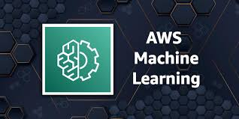
5. Machine Learning and AI
AWS offers pre-built and custom ML and AI tools.
Amazon SageMaker: Build, train, and deploy ML models.
AWS Rekognition: Image and video analysis (e.g., object and face recognition).
Amazon Polly: Converts text into lifelike speech.
Amazon Lex: Build conversational chatbots.
Amazon Forecast: Time-series forecasting.

Slide 27

6. Analytics
Services for big data processing and analytics.
Amazon EMR: Big data processing using Hadoop and Spark.
Amazon Athena: Query data in S3 using SQL.
AWS Glue: Data integration and ETL service.
Amazon Kinesis: Real-time data streaming and analytics.
Amazon QuickSight: Business intelligence and data visualization.

Slide 28

7. Security and Identity
AWS provides tools for securing data and managing access.
AWS IAM: Manage access and permissions for AWS services.
AWS WAF: Web application firewall to protect web apps.
Amazon GuardDuty: Threat detection for AWS accounts.
AWS Shield: Protection against DDoS attacks.
AWS KMS: Managed encryption key storage.

Slide 29
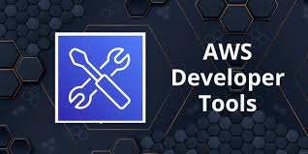
8. Developer Tools
AWS supports DevOps practices with developer tools.
AWS CodePipeline: Continuous integration and deployment (CI/CD).
AWS CodeCommit: Secure Git-based repositories.
AWS CodeBuild: Build and test code in the cloud.
AWS Cloud9: Cloud-based integrated development environment (IDE).

Slide 30

9. Internet of Things (IoT)
AWS offers IoT services for managing connected devices.
AWS IoT Core: Connect and manage IoT devices securely.
AWS Greengrass: Local computing and data management for IoT devices.
AWS IoT Analytics: Analyze IoT data at scale.

Slide 31
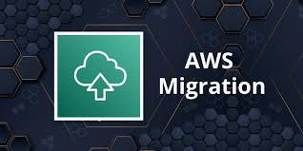
10. Migration and Transfer
AWS supports migration of applications and data to the cloud.
AWS Migration Hub: Centralized tracking for migrations.
AWS Snowball/Snowmobile: Physical devices for transferring large datasets.
AWS Database Migration Service: Migrate databases to AWS.

Slide 32
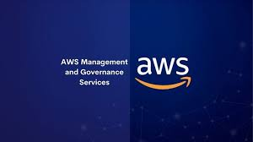
11. Management and Governance
Services to monitor, manage, and optimize AWS usage.
AWS CloudWatch: Monitoring for AWS resources and applications.
AWS CloudTrail: Logs and tracks user activity and API calls.
AWS Config: Resource inventory and compliance auditing.
AWS Auto Scaling: Automatically adjust resources to demand.

Slide 33

12. Media Services
AWS provides tools for creating, processing, and distributing media content.
AWS Elemental MediaLive: Live video processing and delivery.
AWS Elemental MediaConvert: File-based video transcoding.
Amazon IVS: Interactive video streaming.

Slide 34
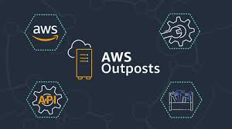
13. Hybrid Cloud
AWS enables integration with on-premises environments.
AWS Outposts: AWS services in on-premises data centers.
AWS ECS Anywhere: Run containers on local hardware.
AWS Backup: Unified backup management for hybrid environments.

Slide 35
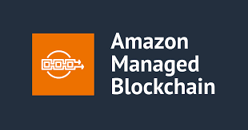
14. Blockchain
AWS supports blockchain development and management.
Amazon Managed Blockchain: Build and manage blockchain networks.
Amazon Quantum Ledger Database (QLDB): Immutable, transparent, and cryptographically verifiable ledger database.

Slide 36

15. Game Development
AWS offers solutions for building and hosting games.
Amazon GameLift: Scalable game server hosting.
AWS Lumberyard: Free game engine integrated with AWS.

Slide 37
6. Provide Personal Information
Enter your full name, contact number, country, and address.
Click "Continue."
7. Enter Billing Information
Enter your credit card or debit card details.
Important: The AWS Free Tier does not require you to pay for most services within the first 12 months, but you will need to provide valid payment information.
8. Verify and Continue
Review the information you've entered and click "Verify and Continue."
9. Select Support Plan
Choose "Basic Support - Free."
10. Confirm Account Creation
Click "Continue" to complete the account creation process.

Slide 38
Let’s get started with AWS Services ….

Slide 39

What is Data-center..?
A data center is a facility that houses an organization's IT infrastructure, including servers, storage systems, networking equipment, and other computing resources. It is designed to store, manage, and distribute data while ensuring security, reliability, and performance. Data centers are critical for running applications, hosting websites, managing databases, and enabling cloud computing services.

Slide 40
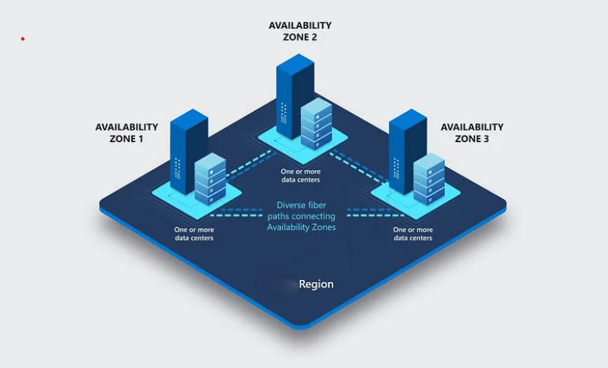
Region: A Region is a geographical area where AWS has multiple data centers. Each region is designed to operate independently and contains multiple isolated locations called Availability Zones.
Global Coverage: AWS has multiple regions around the world (e.g., us-east-1 in Virginia, USA, and eu-west-1 in Ireland).
Isolation: Each region is isolated to ensure fault tolerance and stability, so issues in one region don't affect others.
Data Residency: Allows customers to store data close to their users for better performance and to meet regulatory or compliance requirements.
Service Availability: Not all AWS services are available in every region, so you must choose a region that supports the services you need.
Example:
Region Name: us-east-1
Location: Northern Virginia, USA

Slide 41
Availability Zone (AZ):
An Availability Zone is one or more physically distinct data centers within a region. These data centers have independent power, cooling, and networking but are connected with low-latency, high-speed networks to enable seamless failover.
High Availability: Using multiple AZs helps build fault-tolerant and highly available applications.
Isolation: AZs are isolated from one another to minimize the impact of failures (like power outages) in one AZ.
Connected: AZs in a region are connected with high-speed, redundant, low-latency networks, making it easy to replicate data or distribute workloads.
Naming Convention: AZs are named with a letter suffix, such as us-east-1a, us-east-1b, etc.
Example:
In the us-east-1 region:
AZs: us-east-1a, us-east-1b, us-east-1c

Slide 42
Relationship Between Region and AZ
A region contains two or more Availability Zones.
Example:
Region: us-west-2 (Oregon)
Availability Zones: us-west-2a, us-west-2b, us-west-2c
Why Use Regions and AZs?
Regions:
Choose a region close to your users to reduce latency.
Meet regulatory or compliance requirements (e.g., storing data within a specific country).
Availability Zones:
Distribute your applications across multiple AZs to ensure high availability.
Protect against data center failures.

Slide 43

Identity and Access Management (IAM)
Identity and Access Management (IAM) is a foundational service in Amazon Web Services that helps securely manage access to AWS resources. It allows you to control who is authenticated (signed in) and authorized (has permissions) to use resources within your AWS account.

Slide 44
Features of AWS IAM
IAM Users: Represents individual users (e.g., employees, contractors) who need access to AWS resources.
Each user can have a unique set of credentials (username/password, access keys).
Password policies can be enforced for security.
IAM Groups: Logical collections of IAM users.
Simplifies permission management by attaching policies to a group instead of individual users.
IAM Policies: Documents (written in JSON) that define permissions.
Managed Policies: Created and maintained by AWS or you.
Inline Policies: Embedded directly in a user, group, or role.
IAM Roles: Assigned to entities (AWS services, users, or applications) for temporary access.
Used in scenarios like EC2 accessing S3 or Lambda invoking another service.

Slide 45
Basic Structure of a Policy: A policy is written in JSON and includes
Version: Specifies the policy language version. (The latest is "2012-10-17")
Statement: One or more statements defining the permissions.
Effect: Specifies whether the action is allowed or denied.
"Allow": Grants permission.
"Deny": Explicitly denies permission (overrides allow).
Action: Defines the specific AWS service operations the policy allows or denies.
Format: "service:operation".
Use "*" to specify all actions for a service.
Resource: Specifies the AWS resource(s) to which the policy applies.
Format: Amazon Resource Name (ARN).
Use "*" to apply to all resources.
{
"Version": "2012-10-17",
"Statement": [
{
"Effect": "Allow",
"Action": "s3:ListBucket",
"Resource": "arn:aws:s3:::example-bucket"
}
]
}

Slide 46
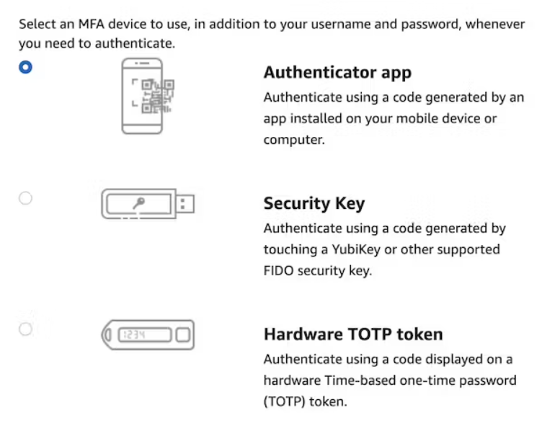
What Is Multi-Factor Authentication
Multi-Factor Authentication (or short MFA) adds another layer of security to any authentication mechanism.
Importance of MFA at AWS
As said in the introduction, with great power comes great responsibility. Your AWS is one of your most significant responsibilities as a compromised account can ruin your financial future in a short time frame.
MFA is one major security layer to prevent account compromise. And it comes for free and with low effort.

Slide 47
You can access AWS services through several methods:
1. Management Console:
Suitable for beginners and occasional users who prefer a visual interface. Log in to the AWS Management Console to access the web interface for AWS services. (protected by password + MFA)
2. AWS CLI:
Ideal for automation, scripting, and advanced users who prefer command-line interaction. Install the AWS CLI for scripting and interacting with AWS services directly from your terminal. protected by access key
3. AWS SDKs:
Best for developers building applications that interact with AWS services. Use AWS SDKs for programming languages like Python (Boto3), Java, Node.js, etc.
For example, install Boto3 in Python:
pip install boto3
4. AWS Tools for Visual Studio Code: Convenient for developers using Visual Studio Code.
5. AWS CloudShell: A handy option for quick tasks and those who prefer a cloud-based environment.

Slide 48
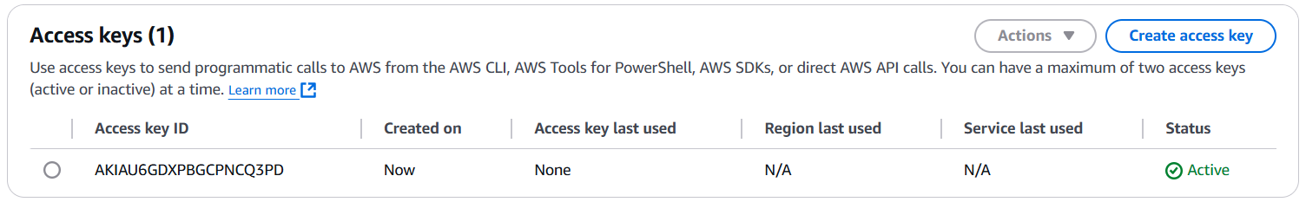
How Access Key Looks: Don’t share them

Slide 49

AWS Cost and Budget Management :
refers to the tools, services, and best practices provided by AWS to help you:
Track your AWS spending
Analyze cost patterns
Forecast future usage
Set budgets and alerts to avoid overspending
Optimize your cloud cost through right-sizing and reserved pricing

Slide 50
Service | Purpose
AWS Cost Explorer | Analyze past and current costs and usage.
AWS Budgets | Set spending limits and get alerts.
AWS Cost Anomaly Detection | Detect unusual spending automatically.
AWS Pricing Calculator | Estimate cost before launching resources.
AWS Cost & Usage Report (CUR) | Detailed CSV report of all AWS usage and billing data.
AWS Trusted Advisor | Recommends cost optimization opportunities.
AWS Billing Dashboard | Centralized place to monitor your costs and invoices.

Slide 51
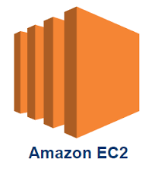
Amazon EC2 (Elastic Compute Cloud)
Amazon EC2 is a core service in AWS that provides scalable virtual servers in the cloud. It enables users to run applications on virtual machines (instances) without worrying about physical hardware.
It mainly consists in the capability of :
• Renting virtual machines (EC2)
• Storing data on virtual drives (EBS)
• Distributing load across machines (ELB)
• Scaling the services using an auto-scaling group (ASG)

Slide 52
Launching an EC2 Instance (Steps)
Login to AWS Console.
Navigate to the EC2 Dashboard.
Click Launch Instance.
Choose an AMI (e.g., Amazon Linux, Windows Server, etc.).
Select an Instance Type.
Configure instance details (e.g., VPC, user data scripts).
Add storage (EBS volumes).
Configure Security Groups.
Review and launch the instance.
Access the instance using SSH or RDP.

Slide 53
Instance Types: An instance type in Amazon EC2 defines the underlying hardware and performance characteristics of an EC2 instance. It specifies the CPU, memory, storage, and networking capacity available to the instance, allowing you to choose the configuration that best fits your application's requirements.
1. General Purpose: Balanced compute, memory, and network (e.g., t2.micro, m5.large).
Use Case: Web servers, development environments.
2. Compute Optimized: High-performance CPUs (e.g., c5.large).
Use Case: Machine learning, gaming servers.
3. Memory Optimized: Large amounts of memory (e.g., r5.large).
Use Case: In-memory databases.
4. Storage Optimized: High-performance storage (e.g., i3.large).
Use Case: Data warehousing, Hadoop.
5. Accelerated Computing: GPU or FPGA for specialized workloads (e.g., p4d).
Use Case: Machine learning, video processing.

Slide 54
Instance Type Naming Convention
Instance types are identified using a naming scheme like m5.large.
Instance Family: Defines the primary use case, e.g., m for general purpose, c for compute-optimized.
Generation: Indicates the version of the instance type, e.g., 5 for the fifth generation.
Size: Specifies the allocation of resources. Examples include small, medium, large, xlarge, and 2xlarge (double the resources of xlarge).

Slide 55
Pricing Models
On-Demand Instances: Pay per second or hour with no long-term commitment. Flexible but costlier than other options.
Reserved Instances: Commit to a 1- or 3-year term for significant cost savings.
Spot Instances: Bid for unused EC2 capacity. Cost-effective but instances can be terminated if your bid price is outbid.
Savings Plans: Flexible pricing based on consistent usage commitment.
Dedicated Hosts/Instances: Run on hardware dedicated to you. Useful for compliance and licensing.

Slide 56
Key pair(login): In EC2 is a set of security credentials used to log in to an Amazon EC2 instance securely. The key pair consists of two parts:
Public Key: This part is stored on the EC2 instance. AWS associates this public key with the instance when it's launched.
Private Key: This part is downloaded and stored locally on your computer. It's used to securely authenticate and connect to the instance via SSH (for Linux) or RDP (for Windows).
Security Group in Amazon EC2 acts as a virtual firewall that controls inbound and outbound traffic for your EC2 instances. It plays a critical role in securing your instances by allowing or denying traffic based on specified rules.
Inbound Rules: Define which incoming traffic is allowed to reach the instance.
Example: Allow SSH (port 22) from a specific IP range.
Outbound Rules: Define which outgoing traffic is allowed from the instance.
Example: Allow all outbound traffic to access the internet.

Slide 57
User Data in Amazon EC2 allows you to run scripts or pass configuration information to an instance at the time it is launched. This is particularly useful for automating initial configuration tasks, such as installing software, configuring settings, or setting up an application.
#!/bin/bash
sudo su
yum update -y
yum install -y httpd
systemctl start httpd
systemctl enable httpd
echo "<html><body><h1>Web Server Content</h1></body></html>" | sudo tee /var/www/html/index.html

Slide 58
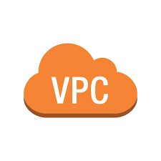
Virtual Private Cloud (VPC) in Amazon Web Services (AWS) is a logically isolated network environment within the AWS cloud. It enables users to launch AWS resources, such as EC2 instances, in a virtual network that they define. VPCs provide full control over networking, including IP address ranges, subnets, routing tables, and security configurations.
Example Use Case: Suppose you're running a web application with the following components
A front-end web server
A back-end application server
A database
Without a VPC:
All resources are on the public internet, exposing them to potential attacks.
Limited control over traffic flow and network segmentation.
With a VPC Architecture:
Create a VPC with two subnets:
Public Subnet: For web servers accessible via the internet.
Private Subnet: For back-end servers and databases.
Use an internet gateway to allow public access to the web server.
Use a NAT gateway for private subnet resources to access the internet securely.

Slide 59
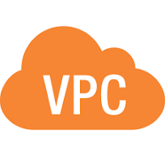
You can have multiple VPCs in an AWS region (max. 5 per region — soft limit)
Max. CIDR per VPC is 5, for each CIDR:
Min. size is /28 (16 IP addresses)
Max. size is / 16 (65536 IP addresses)
Because VPC is private, only the Private IPv4 ranges are allowed:
10.0.0.0 - 10.255.255.255 (10.0.0.0/8)
172.16.0.0- 172.31.255.255 (172.160.0/12)
192.1680.0 - 192.1 68255.255 (192.168.0.0/16)
Your VPC CIDR should NOT overlap with your other networks (e.g., corporate)

Slide 60
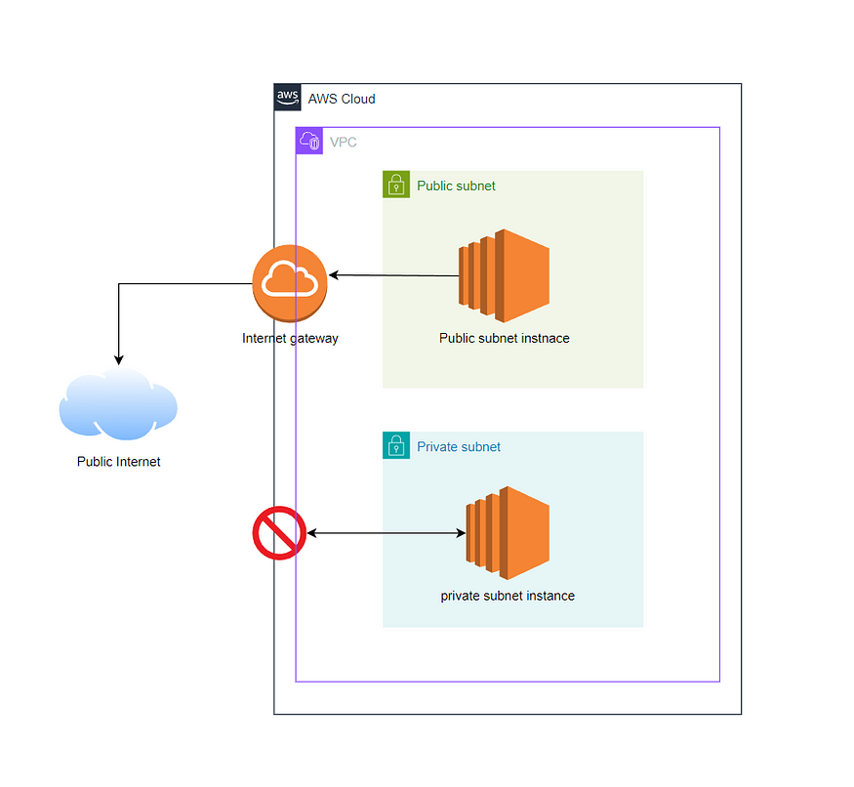
Subnets are subdivisions of a VPC that allow you to segment the network further. Each subnet is associated with a particular Availability Zone (AZ) in a region.
Public Subnets are exposed to the internet, typically containing resources that need internet access (like web servers).
Private Subnets are isolated from the internet, ideal for internal resources like databases.

Slide 61
How AWS Reserves IPs in a Subnet
AWS reserves the first 5 IP addresses and the last 1 IP address in every subnet for internal use
.0: Network address
.1: Reserved by AWS for the VPC router
.2: Reserved for DNS
.3: Reserved for future use
.255: Broadcast address (not supported in VPC)
For example, in 10.0.1.0/24, the usable range is 10.0.1.4 to 10.0.1.254.

Slide 62

Route Table:
A route table contains a set of rules (routes) that dictate where network traffic from a subnet should go.
Each subnet is associated with a route table, which directs the traffic within the VPC and to external networks like the internet or on-premises data centers.

Slide 63
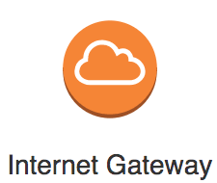
Internet Gateway (IGW):
An IGW is required to allow resources in a VPC’s public subnet to communicate with the internet.
An IGW enables outbound internet access and inbound access to resources with public IP addresses.
Must be created separately from a VPC
One VPC can only be attached to one IGW and vice versa
Internet Gateways on their own do not allow Internet access...
Route tables must also be edited!

Slide 64
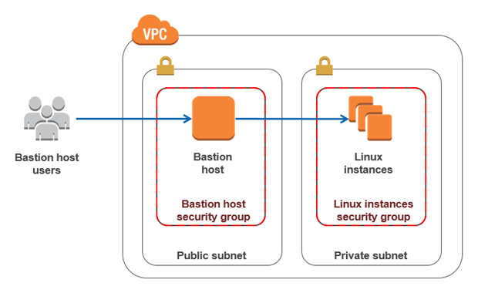
Bastion Host: is a special-purpose server designed to provide secure access to a private network, especially for administrative tasks. It acts as a gateway for managing resources in private subnets or isolated environments, ensuring that sensitive systems remain inaccessible from the public internet.
Acts as the only entry point to the private network for administrators.
Typically accessible via Secure Shell (SSH) or Remote Desktop Protocol (RDP).
Resides in a public subnet of a Virtual Private Cloud (VPC).
Provides access to resources in private subnets without exposing them to the internet.

Slide 65
Scenario: You have an application architecture where the web servers are in a public subnet, and the database servers are in a private subnet to ensure they are not directly accessible from the internet.
Solution: Deploy a bastion host in the public subnet to securely access the database servers for administrative tasks like database updates, troubleshooting, or backups.

Slide 66

Network Address Translation (NAT) in AWS is a mechanism that allows instances in private subnets of a Virtual Private Cloud (VPC) to access the internet or other AWS services without exposing those instances to incoming traffic from external sources. This is essential for maintaining security while enabling outbound communication.
AWS-managed NAT, higher bandwidth, high availability, no administration
Pay per hour for usage and bandwidth
NATGW is created in a specific Availability Zone, uses an Elastic IP
Requires an IGW (Private Subnet => NATGW => IGW)
No Security Groups to manage / required

Slide 67
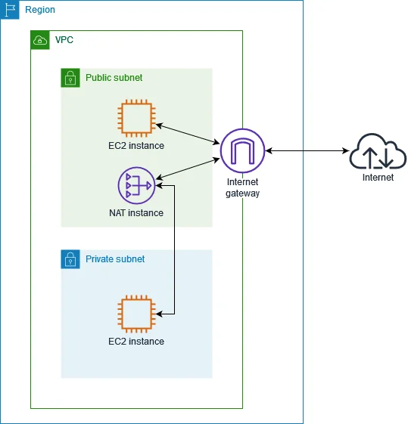
Deployment Steps for NAT Gateway
1. Create a Public Subnet:
Ensure it has a route to the internet via an Internet Gateway.
2. Create a NAT Gateway:
Go to the AWS Management Console → VPC → NAT Gateway.
Assign it to a public subnet and associate an Elastic IP.
3. Update Route Table:
Select the private subnet’s route table.
Add a route directing 0.0.0.0/0 (all internet traffic) to the NAT Gateway.

Slide 68
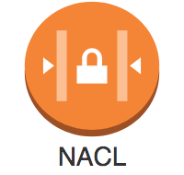
Network Access Control Lists (NACLs) in AWS are a layer of security for your Virtual Private Cloud (VPC). They function as a firewall to control inbound and outbound traffic at the subnet level. NACLs operate alongside security groups to provide additional traffic filtering capabilities.
Subnet-Level Control:
NACLs are attached to subnets and control traffic for all instances within that subnet.
Stateless:
NACLs are stateless, meaning responses to allowed inbound traffic must explicitly be allowed in the outbound rules and vice versa.

Slide 69
Rules Evaluation:
Rules are evaluated in order (from the lowest to highest rule number), Rule number (0 to 32,766).
Each rule can either allow or deny traffic.
If no rules match, traffic is denied by default.
When you see a rule number listed as *, it represents the default implicit deny rule.
This rule automatically blocks any traffic that doesn't explicitly match any of the other rules in the NACL
Rule Components:
Rule Number: Determines the order in which rules are evaluated (from lowest to highest).
Protocol: Specifies the protocol (e.g., TCP, UDP, ICMP).
Port Range: Defines the range of ports for the traffic.
CIDR Block: Specifies the source or destination IP address range.
Allow/Deny: Indicates whether traffic is permitted or denied.
Default vs. Custom NACLs:
Every VPC comes with a default NACL that allows all inbound and outbound traffic.
Custom NACLs deny all traffic by default until explicitly allowed

Slide 70
Use Cases for NACLs
Blocking IP Ranges: Deny traffic from specific IP ranges or geographic regions.
Restricting Access: Enforce subnet-level access control in addition to security groups.
Layered Security: Use NACLs to add an extra layer of defense to your security architecture.
Differences: NACLs vs. Security Groups
Feature | NACL | Security Group
Scope | Subnet-level | Instance-level
State | Stateless | Stateful
Inbound/Outbound | Rules must be configured for both | Automatically tracks connections
Rule Action | Allow or Deny | Allow only
Evaluation Order | Numerical order | All rules evaluated collectively

Slide 71
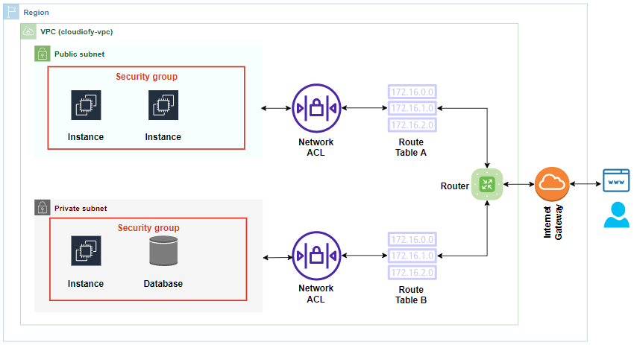

Slide 72
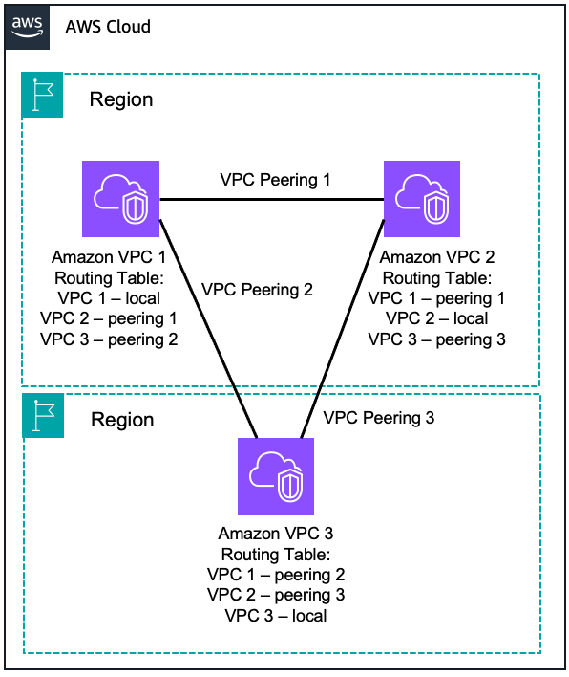
What is VPC Peering?
VPC Peering in AWS is a networking connection that allows you to route traffic between two Virtual Private Clouds (VPCs). This enables the instances in the VPCs to communicate as if they were in the same network.
Private Connectivity: Traffic between the VPCs stays within the AWS backbone, ensuring secure and low-latency communication.
Cross-Region Support: You can create VPC peering connections across regions (known as inter-region VPC peering).
No Overlapping CIDR Blocks: The CIDR blocks of the VPCs must not overlap for a peering connection to work.
One-to-One Relationship: VPC peering is non-transitive, meaning you need to establish a direct peering connection between each pair of VPCs you want to connect.

Slide 73
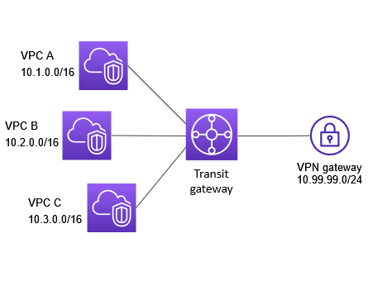
AWS Transit Gateway?
AWS Transit Gateway (TGW) is a central networking hub that connects multiple VPCs (Virtual Private Clouds), on-premises networks, and even other AWS accounts together using a single gateway — instead of creating multiple complex peering connections.
Think of it as a “network router in the cloud” that simplifies communication between many networks.

Slide 74
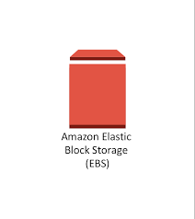
Amazon EBS?
Amazon Elastic Block Store (EBS) is a block-level storage service used with EC2 (Elastic Compute Cloud) instances. It provides persistent, high-performance, and resizable storage volumes that act like virtual hard drives for your EC2 instances.
🔹 Think of it as the “hard disk” or SSD attached to your EC2 virtual machine in the cloud.

Slide 75
🧩 Key Features
Feature | Description
Persistent Storage | Data remains even after the EC2 instance is stopped or terminated (if you choose so).
Block-level Storage | Works like a physical hard drive; can be formatted, partitioned, or used as raw storage.
Attach/Detach | You can attach one EBS volume to one EC2 instance at a time, but you can detach and attach to another instance easily.
Snapshots | You can take backups (point-in-time copies) stored in Amazon S3.
Encryption | Supports encryption at rest and in transit using AWS KMS.
Scalability | Volumes can be resized (increase storage or change type) without downtime.
High Availability | Data is automatically replicated within an Availability Zone (AZ).

Slide 76
💾 Types of EBS Volumes
EBS provides different volume types depending on performance and cost needs:
Type | Description | Use Case | Price (Approx.)
gp3 (General Purpose SSD) | Balanced price and performance | Most workloads, boot volumes | 💲0.08 per GB-month
gp2 (General Purpose SSD – older) | Previous generation, still widely used | General workloads | 💲0.10 per GB-month
io2 / io2 Block Express (Provisioned IOPS SSD) | High-performance, mission-critical | Databases, heavy I/O apps | 💲0.125–0.138 per GB-month (plus IOPS cost)
st1 (Throughput Optimized HDD) | Low-cost HDD for frequent access | Big data, streaming, logs | 💲0.045 per GB-month
sc1 (Cold HDD) | Lowest cost HDD for infrequent access | Backups, rarely used data | 💲0.025 per GB-month
Magnetic (Standard – previous generation) | Older HDD storage, now mostly deprecated | Legacy workloads, archival data | 💲0.05 per GB-month

Slide 77
🔐 EBS Encryption
Managed by AWS KMS (Key Management Service)
Encrypts data:
At rest (stored data)
In transit (moving between EC2 and EBS)
In snapshots
You can also use customer-managed keys (CMK) for more control.
📸 EBS Snapshots
Snapshots are backups of EBS volumes:
Stored in Amazon S3
Incremental – only changes since last snapshot are saved
Can be copied across regions
Can create new EBS volumes from snapshots

Slide 78

🔄 EBS Lifecycle Example
Create Volume Choose size, type, and AZ.
Attach to EC2 Instance
Mount and Use
Take Snapshots for Backup
Detach / Reattach / Resize as Needed
Delete Volume or Restore Snapshot

Slide 79
ELB (Elastic Load Balancing):
Elastic Load Balancing (ELB) is an AWS service that automatically distributes incoming network traffic across multiple targets (like EC2 instances, containers, IPs, or Lambda functions) in one or more Availability Zones.
🔹 In simple terms: It’s like a traffic manager that ensures no single server is overloaded and that your application stays available even if some servers fail.

Slide 80
Benefits of using a load balancer
1️⃣ Improved Performance & Speed 🚀 – Distributes traffic evenly, reducing delays and improving response times.
2️⃣ High Availability & Reliability 💡 – Ensures your application is always accessible by rerouting traffic if a server goes down.
3️⃣ Scalability 📈 – Handles increasing traffic by dynamically adjusting to demand.
4️⃣ Security & DDoS Protection 🔒 – Protects against cyberattacks by filtering and managing traffic intelligently.
5️⃣ Efficient Resource Utilization ⚙️ – Maximizes server efficiency by balancing the workload, preventing overload.
6️⃣ Seamless Maintenance 🛠️ – Allows updates and repairs without downtime by redirecting traffic to healthy servers.
7️⃣ Better User Experience 😊 – Ensures smooth performance, making users happy with fast and reliable service!

Slide 81
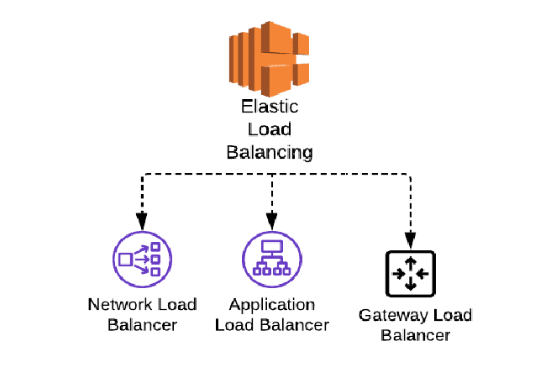
Types of load balancer
Application load balancer
Network load balancer
Gateway load balancer
Classic load balancer (legacy load balancer)

Slide 82

🧩 1️⃣ Application Load Balancer (ALB)
Best for: Modern web apps, APIs, containers (ECS, EKS)
Works at Layer 7 (Application Layer)
Can route traffic based on:
URL path (e.g., /api, /images)
Host-based (e.g., app.example.com, api.example.com)
Headers or Query strings
Supports WebSocket and HTTP/2
Integrates with AWS WAF (Web Application Firewall) for security
🧠 Example:
/app → EC2 App Server
/api → EC2 API Server
/images → S3 bucket

Slide 83
⚡ 2️⃣ Network Load Balancer (NLB)
Best for: Ultra-high performance or low-latency applications
Works at Layer 4 (Transport Layer)
Handles TCP, UDP, and TLS traffic
Extremely fast — can handle millions of requests per second
Static IP support (one per AZ)
Good for IoT, gaming, or financial systems
🧠 Example:
Banking app using TCP-based traffic
DNS queries using UDP

Slide 84
🔒 3️⃣ Gateway Load Balancer (GWLB)
Best for: Deploying and scaling security appliances
Works at Layer 3 (Network Layer)
Routes and distributes traffic to third-party firewalls, intrusion detection systems (IDS), and packet inspection tools
Uses GENEVE protocol to encapsulate traffic
🧠 Example:
Route all VPC traffic through a firewall appliance before reaching applications

Slide 85
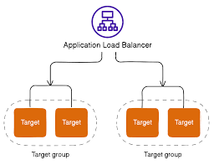
🧰 4️⃣ Classic Load Balancer (CLB)
The oldest AWS load balancer
Works at Layer 4 & 7
Basic load balancing for EC2 instances
Replaced by ALB and NLB (not recommended for new deployments)

Slide 86
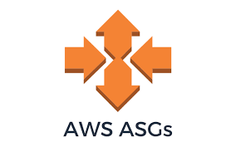
Auto Scaling Group:
Auto Scaling in AWS automatically adds or removes compute resources (like EC2 instances) based on real-time demand.
🔹 Simply put: It helps your application scale up during high traffic and scale down when demand drops — saving money while maintaining performance.

Slide 87
🧱 Main Components of Auto Scaling
Component | Description
Launch Template / Configuration | Defines what to launch (AMI ID, instance type, key pair, security group, etc.)
Auto Scaling Group (ASG) | Logical group of EC2 instances managed together
Scaling Policies | Define when and how scaling happens
CloudWatch Alarms | Monitor metrics to trigger scaling actions
Elastic Load Balancer (ELB) | (Optional) Distributes traffic across instances
Health Checks | Replace unhealthy instances automatically

Slide 88
🔧 Auto Scaling Configuration Parameters
Parameter | Description
Minimum Capacity | Minimum number of EC2 instances that must always run
Desired Capacity | Number of instances you want to maintain under normal conditions
Maximum Capacity | Maximum number of instances that can be launched

Slide 89

🌐 Amazon SNS:
Amazon SNS (Simple Notification Service) is a fully managed messaging service that enables you to send notifications or messages from publishers to subscribers easily and securely.
It supports both application-to-application (A2A) and application-to-person (A2P) communication.

Slide 90
🧩 Key Concepts
Term | Description
Topic | A communication channel to send messages to multiple subscribers.
Publisher | The producer or sender of the message.
Subscriber | The endpoint that receives messages (like Email, SMS, Lambda, SQS, HTTP/S).
Message | The actual content or notification being sent.
Subscription | The link between a topic and an endpoint (email, Lambda, etc).

Slide 91
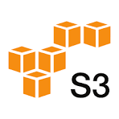
📦 Amazon S3 (Simple Storage Service):
It’s an object storage service designed to store and retrieve any amount of data from anywhere on the web.
Term | Description
Bucket | A container to store objects (like a folder). Each bucket has a unique name across AWS.
Object | The actual file/data stored in a bucket (e.g., image.jpg, report.pdf).
Key | The unique name (path) of the object within a bucket.
Value | The data itself (content of the object).
Metadata | Information about the object (e.g., creation date, size, content type).
Region | Buckets are created in a specific AWS region (like ap-south-1 for Mumbai).

Slide 92
Feature | Description
Versioning | Keeps multiple versions of the same object (protects against accidental deletion).
Replication | Automatically copies objects across AWS regions or within the same region.
Lifecycle Policies | Automates moving data between storage classes or deletion based on age.
Static Website Hosting | Host static websites directly from S3 (HTML, CSS, JS).
Logging and Monitoring | Access logs and metrics via CloudWatch.
Event Notifications | Trigger Lambda, SNS, or SQS when an event occurs (e.g., file upload).
Transfer Acceleration | Speeds up uploads using AWS edge locations.
Object Lock | Prevents data deletion/modification (useful for compliance).
Requester Pays | Bucket owner allows others to download objects but pay themselves.

Slide 93
🔐 Security and Access Control:
Bucket Policies
JSON-based policies attached to buckets.
Controls access at the bucket level.
IAM Policies
Attached to users, groups, or roles.
Controls access to specific S3 resources.
Access Control Lists (ACLs)
Used for fine-grained access at the object level.
Block Public Access
Prevents accidental public exposure.
Encryption
SSE-S3: AWS-managed keys.
SSE-KMS: Customer-managed keys using KMS.
SSE-C: Customer-provided encryption keys.
Client-Side Encryption: Encrypt before uploading

Slide 94
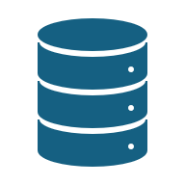
🧭 What Are S3 Storage Classes?
Amazon S3 provides different storage classes to help you store your data cost-effectively based on how frequently you access it and how long you want to retain it.
Each storage class offers a trade-off between:
💰 Cost
⚡ Availability
🕒 Access frequency

Slide 95
Storage Class | Availability | Availability Zones | Use Case | Retrieval Time | Cost (per GB)
S3 Standard | 99.99% | ≥3 | Frequently accessed data | Milliseconds | 💰 Highest
S3 Intelligent-Tiering | 99.9–99.99% | ≥3 | Automatically moves data between access tiers | Milliseconds | 💰 Medium
S3 Standard-IA (Infrequent Access) | 99.9% | ≥3 | Infrequently accessed but important data | Milliseconds | 💰 Lower
S3 One Zone-IA | 99.5% | 1 | Data that can be recreated easily | Milliseconds | 💰 Lower
S3 Glacier Instant Retrieval | 99.9% | ≥3 | Archival data that needs instant access | Milliseconds | 💰 Low
S3 Glacier Flexible Retrieval | 99.9% | ≥3 | Long-term archives (rarely accessed) | Minutes to hours | 💰 Very Low
S3 Glacier Deep Archive | 99.9% | ≥3 | Long-term cold storage (7–10 years) | Hours | 💰 Cheapest

Slide 96
Use Case | Example
Backup and Restore | Storing system backups or snapshots.
Data Lake / Big Data | Central repository for analytics data (with Athena, Glue, EMR).
Static Website Hosting | Hosting portfolio sites or documentation.
Application Storage | Store app images, logs, or user files.
Disaster Recovery | Cross-region replication for DR solutions.
Machine Learning Datasets | Store training and test data for ML models.
🧩 Common Use Cases

Slide 97
🧮 Pricing Factors:
You pay for:
Storage used (per GB per month)
Requests (GET, PUT, DELETE)
Data Transfer (outbound from AWS)
Management Features (like replication or analytics)
✅ Free Tier: 5 GB Standard Storage + 20,000 GET + 2,000 PUT requests + 15 GB data transfer out (for 12 months)

Slide 98

🌐 Amazon EFS:
Amazon EFS (Elastic File System) is a fully managed, scalable, shared file storage service for Linux-based workloads running on AWS Cloud or on-premises systems.
It provides a Network File System (NFS) interface that can be mounted on multiple EC2 instances at the same time.

Slide 99
Feature | Description
Fully Managed | AWS automatically handles infrastructure, scaling, patching, and backups.
Scalable Storage | Automatically grows and shrinks as you add or remove files — up to petabytes.
Shared Access | Multiple EC2 instances can access the same data concurrently.
Elastic Performance | No need to provision capacity; it scales automatically.
POSIX-Compliant | Supports standard Linux file system semantics.
Regional Service | Data is stored across multiple Availability Zones for high availability.
Secure | Supports encryption (at rest and in transit), IAM policies, and VPC access control.

Slide 100
🧩 EFS Performance Modes
Mode | Description | Best For
General Purpose (Default) | Low latency, ideal for most applications. | Web servers, CMS, development environments.
Max I/O | Higher latency but better for massive parallel workloads. | Big data, analytics, media processing.
📊 EFS Throughput Modes
Mode | Description | When to Use
Bursting Throughput (Default) | Scales with storage size. | Normal workloads.
Provisioned Throughput | You can set throughput independent of storage. | High-performance workloads with small data sets.
Elastic Throughput (New) | Automatically adjusts throughput up and down as needed. | Variable workloads without manual tuning.

Slide 101
🧩 EFS vs EBS vs S3
Feature | EFS | EBS | S3
Type | File Storage | Block Storage | Object Storage
Access | Multiple EC2 instances (shared) | Single EC2 instance | Global (via API/HTTP)
Protocol | NFS | Attached as disk | REST API
Scalability | Automatic | Manual (resize volume) | Virtually unlimited
Use Case | Shared file system | Databases, OS | Backup, static website, big data
Performance | Medium to High | Highest | Varies (based on tier)

Slide 102

AWS Lambda: is a serverless compute service provided by Amazon Web Services (AWS) that lets you run code without provisioning or managing servers.
⚙️ How AWS Lambda Works
Write your function — in Python, Node.js, Java, Go, or C#.
Upload to Lambda — through the AWS Management Console, AWS CLI, or an automated pipeline.
Trigger it — Lambda runs in response to events (like an S3 upload, API request, or scheduled time).
Execution environment — Lambda launches a secure container (runtime) and executes your code.
Automatically scales — Lambda adds more instances as requests increase.
Stops automatically — When there are no requests, Lambda stops running and you stop paying.

Slide 103
🧩 AWS Lambda Architecture
Component | Description
Function | The unit of deployment — your code + configuration.
Handler | The method Lambda calls to start executing your function.
Runtime | The programming language environment (Python, Node.js, etc.).
Event Source | The trigger that invokes your Lambda (e.g., API Gateway, S3, DynamoDB).
Execution Role (IAM Role) | Defines permissions for your Lambda to access AWS resources.
Environment Variables | Store settings or secrets like DB credentials.
Layers | Reusable shared libraries for multiple functions.
Concurrency | How many executions can run simultaneously.
/tmp Storage | Temporary 512 MB–10 GB disk for runtime processing.

Slide 104
💰 Pricing (Pay-As-You-Go):
Factor | Description
Requests | First 1 million per month → Free, then $0.20 per 1M requests
Duration | Based on GB-second (memory x execution time)
Memory Allocation | 128 MB – 10 GB; higher memory → faster performance but more cost
Provisioned Concurrency (optional) | Extra cost for keeping functions warm
Example:
Function runs 200 ms, 512 MB memory, 1M times/month → Cost ≈ $0.80/month

Slide 105
💡 Advantages of AWS Lambda
Advantage | Description
No server management | AWS handles provisioning, scaling, and maintenance.
Automatic scaling | Handles 1 to thousands of requests per second.
Cost-efficient | Pay only for usage, not idle time.
Event-driven | Works perfectly with AWS events like S3 uploads or API calls.
Highly available | Multi-AZ design ensures fault tolerance.
Easy integration | Works with over 200 AWS services.

Slide 106
⚠️ Limitations of Lambda
Limitation | Description
Max Execution Time | 15 minutes per invocation
Ephemeral Storage | /tmp directory limited to 512 MB–10 GB
Cold Start | Slight delay for infrequent invocations
Limited Customization | No control over OS or hardware
State Management | Stateless by default (must use DynamoDB/S3 for persistence)

Slide 107
🔁 When to Use AWS Lambda
✅ Best For
Image/file processing (via S3 triggers)
REST APIs (via API Gateway)
Scheduled jobs (using CloudWatch)
Stream processing (Kinesis, DynamoDB)
Chatbots, automation, notifications
IoT event handling
❌ Avoid Lambda For
Long-running workloads (>15 min)
Heavy background processing
Real-time video transcoding
Applications needing local storage/state

Slide 108

CloudWatch:
Amazon CloudWatch is a monitoring, observability, and alerting service by AWS. It helps you collect, analyze, and act on data from your AWS resources, applications, and services.
🧩 In simple words — CloudWatch is like the eyes and ears of your AWS environment. It monitors performance, sends alerts, and even triggers automated actions when something goes wrong.

Slide 109
⚙️ Feature of CloudWatch
1. Metrics
Metrics are time-ordered data points representing resource performance.
Examples:
EC2: CPUUtilization, NetworkIn, NetworkOut
EBS: VolumeReadOps, VolumeWriteOps
Lambda: Invocations, Errors, Duration
CloudWatch stores these metrics for 15 months, allowing you to view historical performance trends.
2. Alarms
Used to trigger notifications or actions when a metric crosses a defined threshold.
Example:
If EC2 instance CPU utilization > 80% for 5 minutes, send an SNS alert or auto scale the instance.
Alarm States:
OK – Metric within threshold
ALARM – Metric exceeds threshold
INSUFFICIENT_DATA – Not enough data

Slide 110
3. Logs
CloudWatch Logs helps you collect, monitor, and analyze log files from:
AWS services (e.g., Lambda, ECS, CloudTrail, etc.)
On-premises servers (via the CloudWatch Agent)
You can create Log Groups (containers) and Log Streams (sequences of log events).
✅ You can use CloudWatch Logs Insights to run queries on log data for troubleshooting and analysis.
4. Events (CloudWatch Events / EventBridge)
Detects changes in AWS resources and responds automatically.
Example: If an EC2 instance stops, trigger a Lambda function to restart it.
Event sources:
AWS services (e.g., EC2, S3, RDS)
Custom applications
SaaS apps (through EventBridge)

Slide 111
5. Dashboards
Visualize your data with custom dashboards.
Combine metrics and alarms from multiple services (e.g., EC2 + RDS + Lambda) into one real-time view.
Widgets available: line graphs, numbers, gauges, text, etc.
6. Contributor Insights
Helps identify top contributors to a metric.
Example: Top IPs causing high API Gateway latency.
7. Anomaly Detection
Uses machine learning to automatically learn normal metric behavior and detect anomalies.
Example: Detect abnormal CPU usage even when thresholds are not explicitly set.

Slide 112
🧰 Example: Creating an Alarm for EC2 CPU Usage
Open CloudWatch Console.
Go to Alarms → Create Alarm.
Select Metric → EC2 → Per-Instance Metrics → CPUUtilization.
Define threshold (e.g., >80% for 5 minutes).
Set action → Notify via SNS topic.
Create Alarm. ✅

Slide 113

AWS CloudTrail is a logging and auditing service that records all API calls and account activity across your AWS environment.
It helps you:
Track who did what, when, and from where in your AWS account.
Maintain security, compliance, and operational audits.
Detect unauthorized or suspicious activities.
In short — CloudWatch monitors “what’s happening”, while CloudTrail tracks “who did it.”

Slide 114
🧩 Key Components of CloudTrail
1. Event
Each activity in AWS is an event. Example: Creating an EC2 instance = RunInstances API call Deleting an S3 bucket = DeleteBucket API call
2. Trail
A Trail is a configuration that defines where your events are recorded and stored.
3. Event History
CloudTrail keeps the last 90 days of recent activity in Event History (in the console).
You can filter by time, user, service, or event name.
Ideal for quick lookups without setting up a full trail

Slide 115

Simple Queue Service (SQS):
It is a fully managed message queuing service that allows you to decouple and scale microservices, distributed systems, and serverless applications.
It helps components in your application communicate asynchronously by sending and receiving messages through a queue — without requiring direct connectivity.

Slide 116
Key Concepts
Queue | A temporary storage location for messages waiting to be processed.
Message | The data or task sent by the producer to be processed by the consumer (up to 256 KB per message).
Producer (Sender) | The component that sends messages to the queue.
Consumer (Receiver) | The component that retrieves and processes messages from the queue.
Polling | The process by which consumers retrieve messages from the queue.

Slide 117
🧱 Types of SQS Queues
1. Standard Queue (Default)
Unlimited throughput
At-least-once delivery
Best-effort ordering (message order isn’t guaranteed)
Ideal for high-throughput applications like log processing, background tasks, etc.
2. FIFO Queue (First-In-First-Out)
Strict message ordering
Exactly-once processing
Limited throughput: up to 3000 messages per second with batching.
Ideal for financial transactions, inventory updates, or workflow systems where order matters.

Slide 118
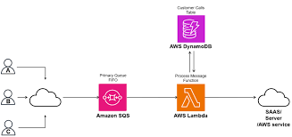
⚙️ How SQS Works (Architecture Flow)
Producer sends a message → queue.
SQS stores the message redundantly across multiple servers and Availability Zones.
Consumer polls the queue and retrieves messages.
Message becomes invisible for the visibility timeout period.
If processing succeeds → consumer deletes the message.
If processing fails → message reappears for another consumer to retry or goes to DLQ.

Slide 119
🧮 Core Parameters
Parameter | Default | Max | Purpose
Message size | – | 256 KB | Size of a single message
Message retention | 4 days | 14 days | Duration a message remains in the queue
Visibility timeout | 30 sec | 12 hours | Prevents reprocessing of in-flight messages
Delay seconds | 0 | 900 (15 mins) | Time to delay message delivery
Max message size | 262,144 bytes | — | 256 KB limit

Slide 120
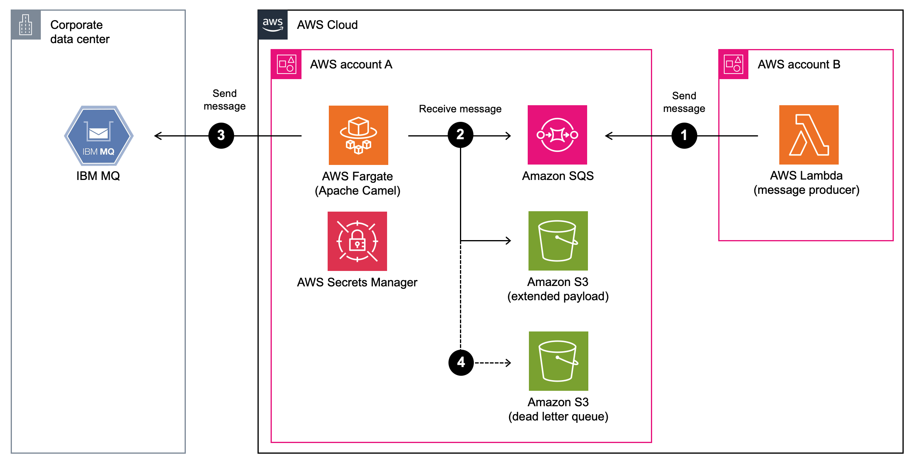
💬 Integration with Other AWS Services
AWS Lambda – Automatically trigger Lambda on new messages.
Amazon EC2 / ECS / EKS – For background job processing.
SNS (Simple Notification Service) – Combine for pub/sub pattern (SNS → SQS fan-out).
CloudWatch – Monitor queue metrics and alerts.
Step Functions – Coordinate workflow between distributed systems.

Slide 121
🧠 Use Cases
Decoupling Microservices | Prevents direct dependency between services.
Asynchronous Processing | For background tasks like image resizing, email sending, etc.
Load Leveling | Smooths traffic spikes by queuing tasks for later processing.
Reliable Communication | Ensures message delivery even if some services fail temporarily.
Message Buffering | Between web servers and database writes.
💵 Pricing Overview
Number of requests (first 1 million per month are free)
Data transfer (standard AWS data transfer costs)
Long polling (charged per receive message request)
🔹 Example: $0.40 per million requests after the free tier.

Slide 122

RDS (Relational Database Service) is a fully managed database service provided by AWS. It makes it easy to set up, operate, and scale a relational database in the cloud.
AWS handles the infrastructure tasks like:
Hardware provisioning
Database setup
Patching
Backups
Scaling
So you can focus on application development rather than database maintenance.

Slide 123
🧩 Supported Database Engines
Database Engine | Description
Amazon Aurora | Cloud-optimized version of MySQL/PostgreSQL (high performance, high availability).
MySQL | Open-source and widely used relational DB.
PostgreSQL | Advanced open-source DB with complex query and JSON support.
MariaDB | Fork of MySQL with better performance and security features.
Oracle | Enterprise-grade commercial database.
SQL Server | Microsoft’s relational database for .NET-based applications.

Slide 124
🧱 How RDS Works (Architecture)
You choose a DB engine (e.g., MySQL).
AWS provisions an EC2 instance in the background and installs the DB engine.
You connect to the database endpoint using standard SQL clients (e.g., MySQL Workbench).
AWS manages backups, patching, monitoring, and scaling automatically.
You only manage your data and schema.

Slide 125
⚙️ Core Components
DB Instance | The basic building block of RDS — it’s a virtual database environment.
DB Parameter Group | Defines configuration values for the database engine.
DB Snapshot | A backup of the entire DB instance (manual or automatic).
Subnet Group | Defines the VPC subnets where your RDS instance will reside.
Security Group | Controls inbound/outbound traffic to the DB instance.
Endpoint | The connection string (DNS name) for your database.

Slide 126
🔄 High Availability & Failover
✅ Multi-AZ Deployment
RDS automatically creates a primary DB instance and a standby replica in a different Availability Zone (AZ).
AWS automatically fails over to the standby in case of outage.
Provides 99.95% availability.
🧩 Example: Your app connects to the same endpoint, and even if the primary instance fails, AWS redirects it automatically to the standby.
✅ Read Replicas
Used for scaling read-heavy workloads.
You can create up to 5 read replicas for MySQL, PostgreSQL, or Aurora.
Replicas are asynchronous copies of the primary database.
🧩 Example: Use one database for writes (primary) and multiple replicas for reads (reporting, analytics).

Slide 127
🔒 Security Features
VPC | Launch RDS inside your own private cloud.
Encryption | Supports encryption at rest (AWS KMS) and in transit (SSL/TLS).
IAM Authentication | Control database access using IAM users/roles.
Security Groups | Network-level firewall rules.
Automatic Patching | Keeps your DB engine updated and secure.

Slide 128
💾 Backup and Recovery
🔹 Automated Backups
Enabled by default.
You can restore your DB to any point in time within your retention period (1–35 days).
🔹 Manual Snapshots
Created manually and retained until deleted.
Used for long-term backups or migrations.
🔹 Point-in-Time Recovery
Restores database to a specific timestamp (e.g., just before an issue occurred).

Slide 129

🌐 What is Amazon Route 53?
Amazon Route 53 is a highly available and scalable Domain Name System (DNS) web service provided by AWS.
It is designed to:
Route end-user requests to Internet applications,
Translate domain names (like www.example.com) into IP addresses (like 192.0.2.1),
Monitor health of applications,
And register/manage domain names.

Slide 130
Functions of Route 53
Function | Description
Domain Registration | You can buy and manage domain names directly from Route 53 (like example.com).
DNS Routing | Translates human-readable domain names into IP addresses of servers or AWS resources (like EC2, S3, ELB).
Health Checking & Monitoring | Continuously checks the health of endpoints and routes traffic only to healthy ones.
Traffic Management | Distributes traffic using different routing policies for performance, failover, or latency optimization.

Slide 131
🧩 How Route 53 Works
User enters a domain name (like www.ashacloud.com) in a browser.
DNS Resolver (like your ISP) sends a query to Route 53 to find the IP address.
Route 53 checks the hosted zone for that domain and returns the corresponding IP (for an EC2, ELB, CloudFront, etc.).
User’s browser then connects directly to that IP address.
📁 Core Components of Route 53
1. Hosted Zones: A Hosted Zone is like a container for DNS records.
Public Hosted Zone: Used for public domains accessible over the internet. Example: ashacloud.com
Private Hosted Zone: Used within a VPC (Virtual Private Cloud) for internal DNS resolution.

Slide 132
2. DNS Record Types
Record Type | Description | Example
A Record | Maps a domain to an IPv4 address. | app.ashacloud.com → 192.0.2.44
AAAA Record | Maps to an IPv6 address. | app.ashacloud.com → 2001:db8::1234
CNAME | Alias one domain to another. | www.ashacloud.com → ashacloud.com
MX | Mail server records for email routing. | ashacloud.com → mail.ashacloud.com
NS | Identifies the authoritative name servers for the zone. | Provided by Route 53.
SOA | Start of Authority — contains zone information. | TTL, serial number, etc.
TXT | Stores text data (used for verification, SPF, DKIM). | "v=spf1 include:_spf.google.com ~all"
Alias Record (AWS specific) | AWS extension to point to AWS resources (like ELB, CloudFront, S3) without extra cost. | ashacloud.com →

Slide 133
🧭 Routing Policies :- routing policies decide how Route 53 responds to DNS queries.
Policy Type | Description | Example Use Case
Simple Routing | Returns one record (IP). No health checks. | Single web server or app.
Weighted Routing | Distributes traffic by percentage (weights). | 70% to primary, 30% to beta version.
Latency-based Routing | Sends users to the region with lowest latency. | Route users from India to Mumbai region, US users to Virginia.
Failover Routing | Routes traffic to primary, switches to secondary if primary fails (based on health checks). | Disaster recovery.
Geolocation Routing | Routes based on user’s geographic location. | Users in Europe → EU servers, Asia → Singapore servers.
Geo-proximity Routing | Routes based on location bias and proximity of users/resources (requires Traffic Flow). | Advanced global apps.
Multi-Value Answer Routing | Returns multiple healthy records to improve availability. | Load balancing among EC2 instances.

Slide 134
💸 Pricing Overview
Feature | Pricing
Hosted Zone | $0.50 per hosted zone / month
DNS Queries | Based on volume (e.g., $0.40 per million queries for first billion)
Health Checks | $0.50 per health check / month
Domain Registration | Varies by TLD (like .com, .in, etc.)

